Slide 1
RENDERING
REAL-TIME
Brief Introduction
A presentation of Intro to Computer Science
鲁劲帆
任雨奇
李天宇

Slide 2
The Reasons
1
Make some amazing games
Need better Quality and Fluency
E.g., excellent gaming technology and higher FPS
PART
Have better understanding of Computer graphics
Focus on Lighting and Shadow

Slide 3
Lighting
2
Phong Lighting Model
Suppose perfect surface
PART
Physically Based Rendering
Based on the microfacet surface
Be energy conserving
Reproduction physical based BRDF(Bidirectional Reflection Distribution Function)

Slide 4
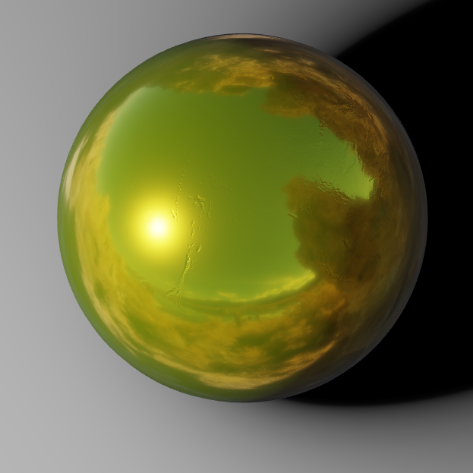
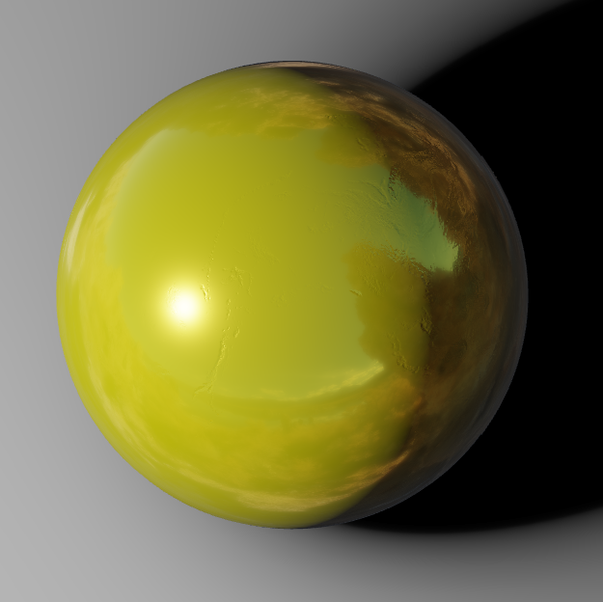


Metal Materials have no diffuse reflection, that is, only specular highlights. This is due to the complex refractive index of the metal, and the light will attenuate quickly after entering the metal. So, the scattering part is very small.
Roughness=0.2
How do we describe a surface
Roughness=0.5
Metallic=0.8
Metallic=0.5
The surface of all materials is considered as be composed of many tiny planes with different orientations. Smoother leads to order, rougher leads to disorder.
To be more specific, roughness describe the probability that the half angle vector coincides with the normal direction of the microfacet

Slide 5
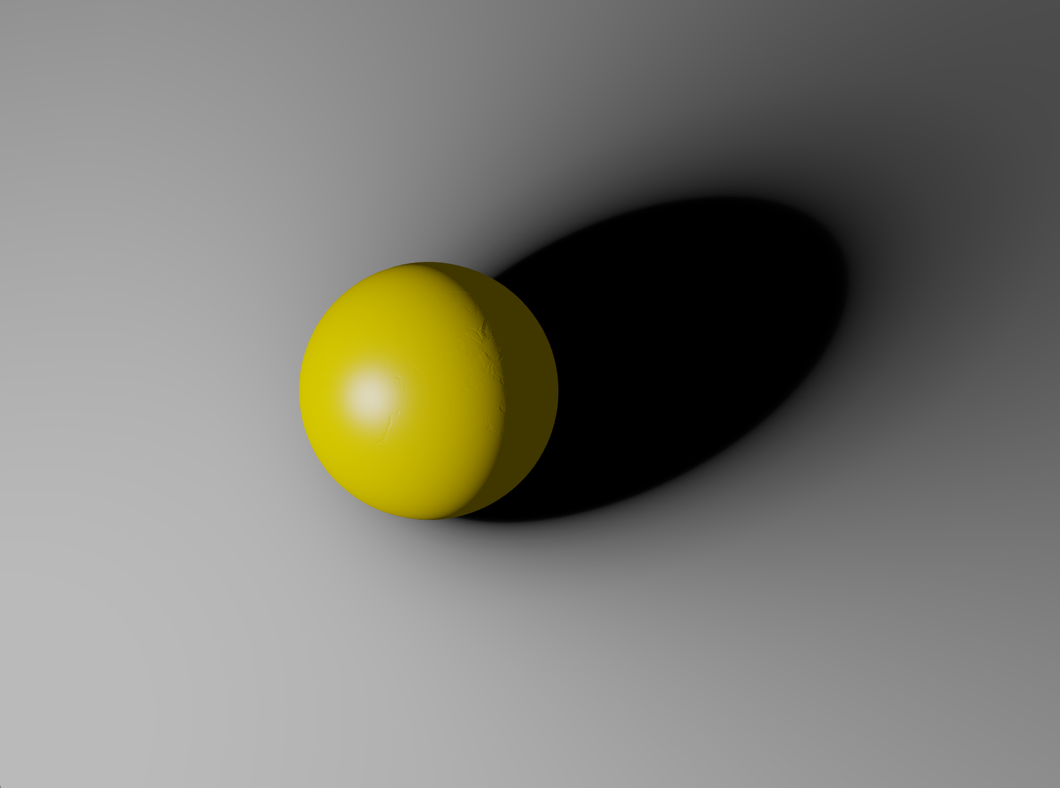
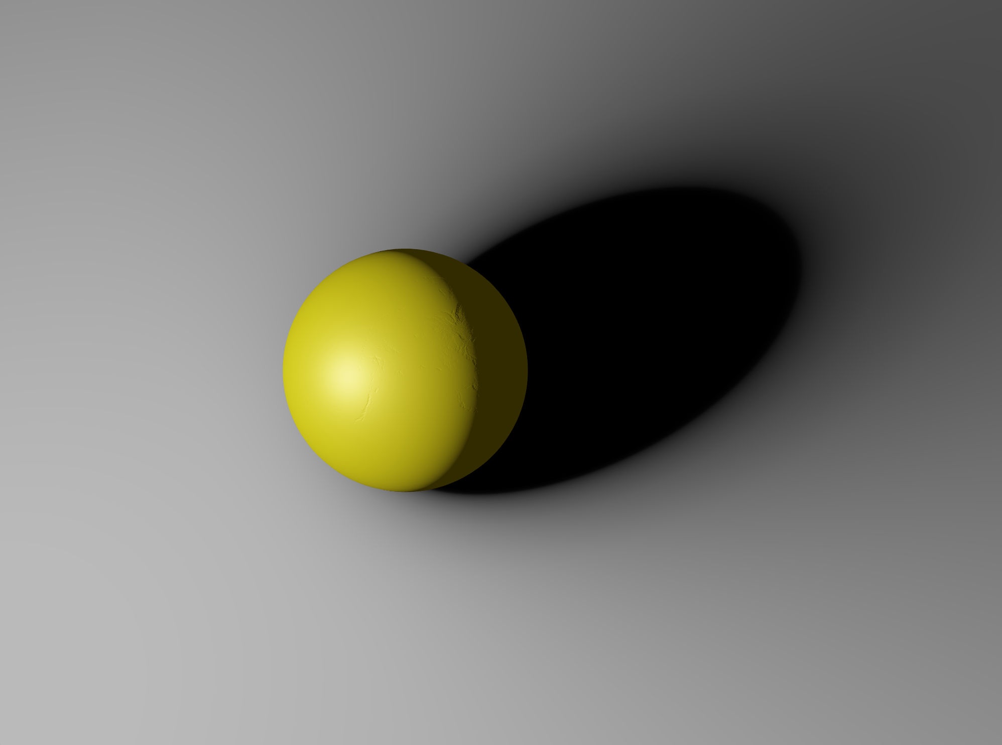
Compare
Under single light rendering
There is not a big gap
Between Phong and PBR
Phong Lighting Model
PBR
Phong is much simpler than PBR, so why people use PBR?

Slide 6

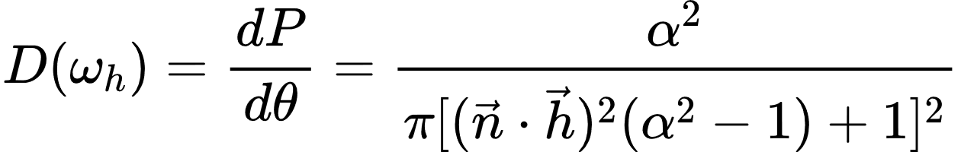


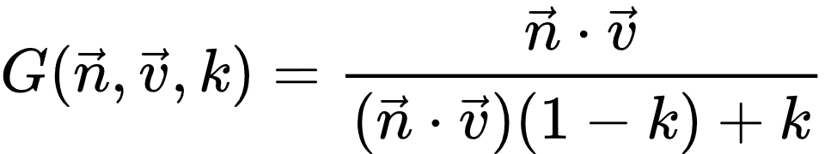

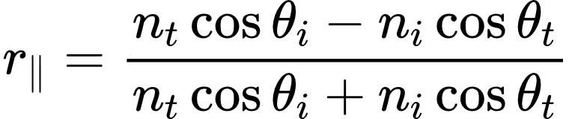
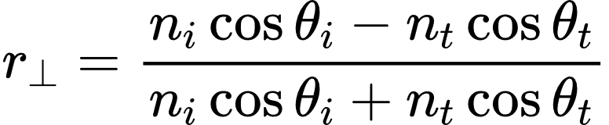
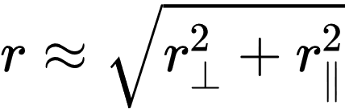
Complete Formula
Lighting Equation
$ω_{i}$ is the unit vector of the incident direction
$ω_{o}$ is the unit vector of the reflection direction
Normal Distribution Function
Geometry Function and
Heavy Math!!!
is calculated by roughness
Approximation of Fresnel’s Formula
In physics, Fresnel's formula describes the reflectance of ideal specular reflection of light at the interface of a medium.
We can derive the Fresnel formula through the boundary value relation of the electromagnetic field:
Schilick approximation of Fresnel's formula:

Slide 7
Shadow
3
Traditional Shadow Techniques
Shadow Map and PCF(Percentage-Closer Filter)
PART
Soft Shadow
Based on PCF, people proposed PCSS and VSSM
New technique: SDFSS(Signed Distance Filed Soft Shadow)

Slide 8
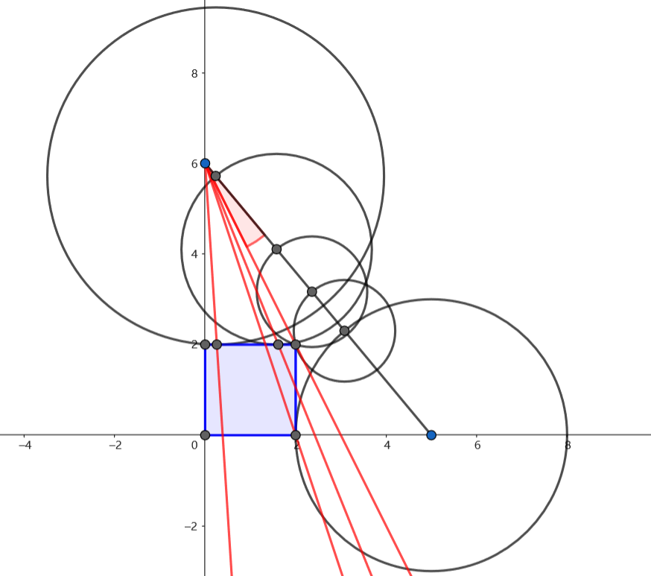
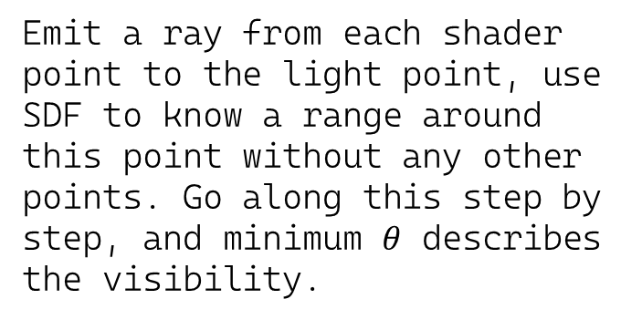
Emit a ray from each shader point to the light point, use SDF to know a range around this point without any other points. Go along this step by step, and minimum $θ$ describes the visibility.
Signed Distance Field Soft Shadow
But it’s too difficult to reproduction!!!

Slide 9

Correct Signed Distance Field Soft Shadow
Signed Distance Field Soft Shadow

Slide 10
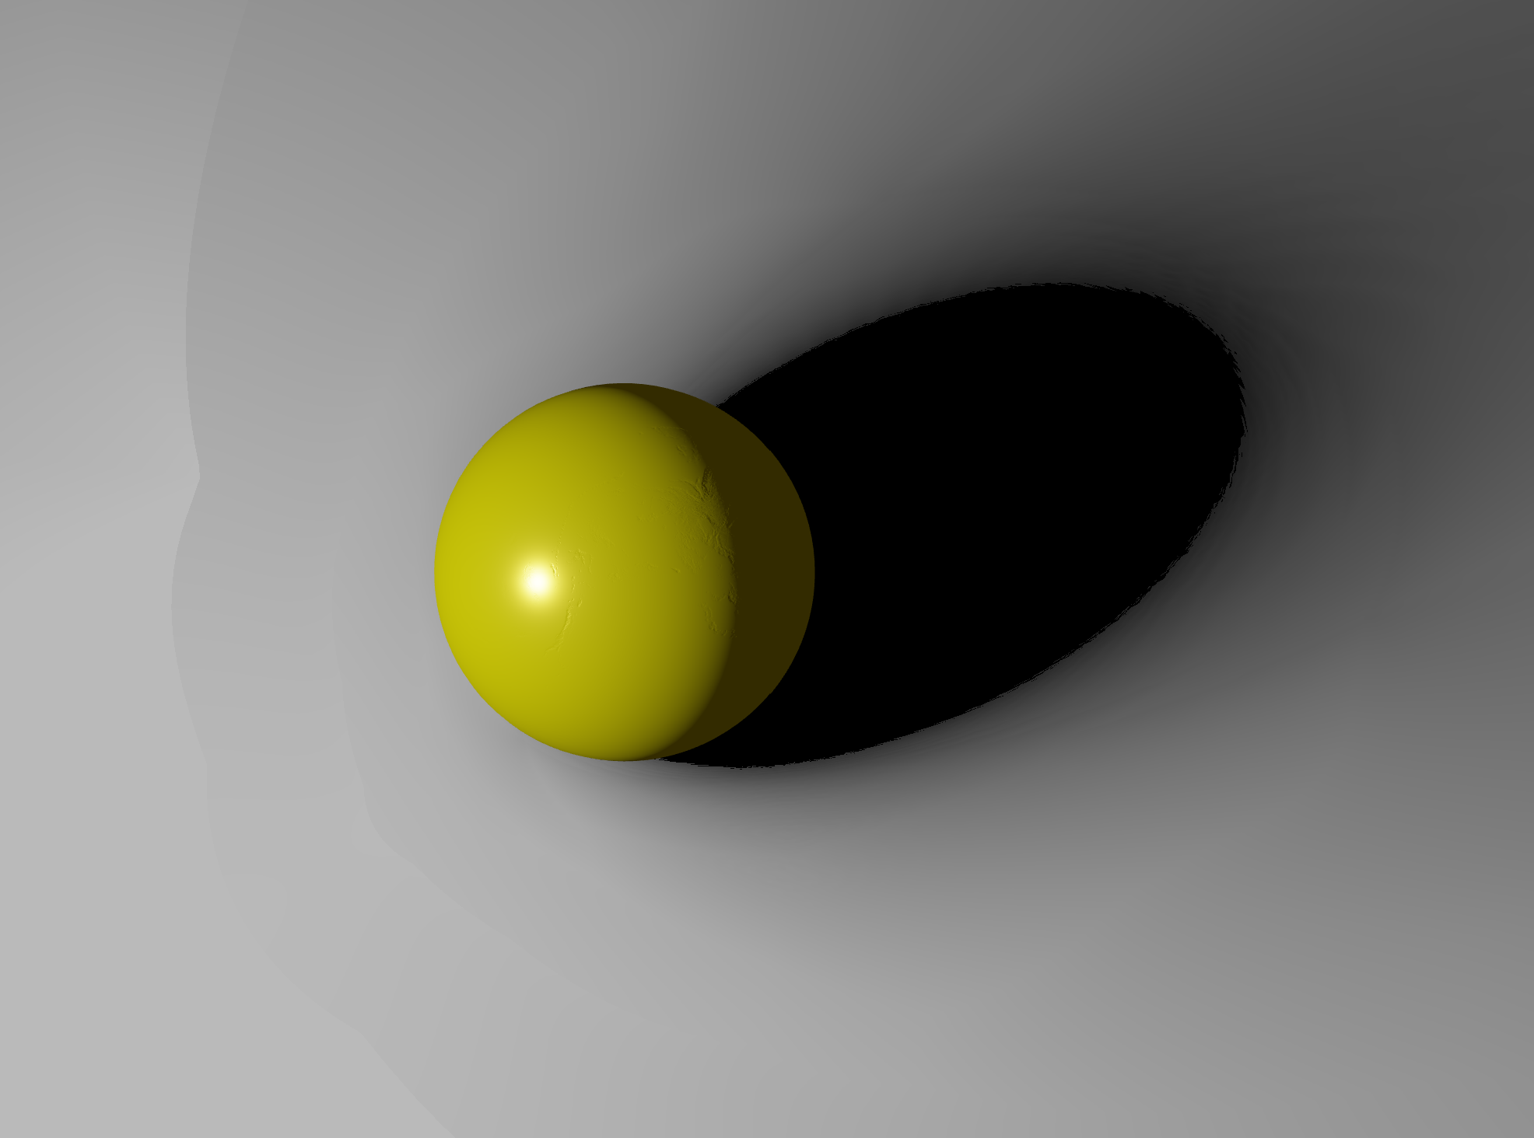
Without Draw Sphere on Light Position
Signed Distance Field Soft Shadow

Slide 11

Use Some Approximation to Generate SDF
We generate a cube SDF which is slightly larger than object, since the object is much smaller than whole scenes. Then, when we need to query any point on the scene, we use the smallest distance between this point to the cube plus the preprocessed SDF distance of the intersection point of such shortest distance.
Signed Distance Field Soft Shadow

Slide 12

Why don’t use vector to describe distance?
It could interpolate better when we query distance
Floating point precision is not important
So, we can compress the vector to a float to achieve the same memory consumption
Question
When we generate the SDF, we actually already know this vector and can directly get it
Dramatically decrease incompleteness of the edges

Slide 13
Summary
4
Lighting and Shadows
Explore and Reproduction some state-of-art technology
PART
Coding
We wrote everything in OpenGL all by ourselves.
Everything is public on Github(at last almost 2000 lines)
https://github.com/LJFYC007/Cosmos

Slide 14
Something Funny
6
PART

Slide 15
References
Phong, Bui Tuong. "Illumination for computer generated pictures." Communications of the ACM 18.6 (1975): 311-317.
5
Pharr, Matt, Wenzel Jakob, and Greg Humphreys. Physically Based Rendering: From Theory to Implementation. No. BOOK. Morgan Kaufmann Publishers Inc., 2016.
Schlick, Christophe. "An inexpensive BRDF model for physically‐based rendering." Computer graphics forum. Vol. 13. No. 3. Edinburgh, UK: Blackwell Science Ltd, 1994.
Abramsky, Samson, Radha Jagadeesan, and Pasquale Malacaria. "Full abstraction for PCF." Information and computation 163.2 (2000): 409-470.
PART
Fernando, Randima. "Percentage-closer soft shadows." ACM SIGGRAPH 2005 Sketches. 2005. 35-es.
Daniel Wright.Advances in Real-Time Rendering in Games. Advances in Real-Time Rendering in 3D Graphics and Games. https://advances.realtimerendering.com/s2015/DynamicOcclusionWithSignedDistanceFields.pdf. Accessed 10 December 2022.
Sloan, Peter-Pike, Jan Kautz, and John Snyder. "Precomputed radiance transfer for real-time rendering in dynamic, low-frequency lighting environments." Proceedings of the 29th annual conference on Computer graphics and interactive techniques. 2002.

